Slide 1
ML Session - 8
LIME- Model Explainability

Slide 2
LIME-Local Interpretable Model-agnostic Explanations
LIME Model
Features
Model
Output
Target

Slide 3

Math Behind LIME
Simple opt. function of linear model
Complex Model
Simple Interpretable Model
Local Neighborhood

Slide 4
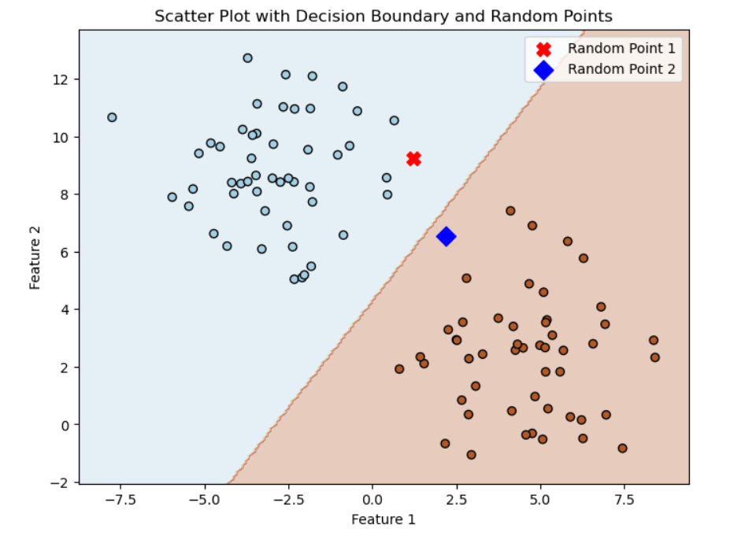
EXAMPLE FOR LIME

Slide 5
CODE

